Slide 1


WIRELESS NETWORK ATTACKS USING SUPERVISED MACHINE LEARNING TECHNIQUES

Slide 2

FINAL REVIEW - 27-03-2024
TEAM MEMBERS – CSE B
MADHUSRI .V – 111520104088
KEERTHANA .E - 111520104072
GUIDE:
DR. A. GNANASEKAR M.Tech ,Ph.D.,

Slide 3


AGENDA
Objective
Abstract
Literature survey
Proposed work
Details about the modules
Output and demo of completed modules

Slide 4
OBJECTIVE
Identify key features for predicting various types of attacks in Wireless Sensor Networks (WSN), including BLACKHOLE, FLOODING, GRAYHOLE, NORMAL, and SCHEDULING.
Utilize machine learning classification methods to build predictive models capable of discerning between different attack types.
Inform model and hyperparameter selection by analyzing general trends in feature importance.
Enable the creation of a function capable of accurately classifying new input data into discrete attack classes.

Slide 5
ABSTRACT
Supervised machine learning techniques are utilized for network attack prediction.
Data collection and preprocessing are conducted to extract pertinent features.
Performance evaluation of various algorithms is undertaken.
Interpretability of trained models is explored to unveil attack patterns.
Insights derived aid in the development of effective defense strategies for network administrators.

Slide 6
LITERATURE SURVEY
AUTHOR | METHODOLOGY | FEATURES | CHALLENGES
KimKD., and KumarP. Year : 2012 Cyber-Physical Systems | 1.Fault Injection during Training Phase. 2.Generation of Fooling Inputs. 3.Exploitation at Deployment. | Fault Injection during Training. Targeting Re LU Activation Functions.. Constraint Solving for Fooling Inputs. Stealthy Exploitation. | Complexity of Constraint Solving. Detection and Mitigation: Generalization and Robustness: Ethical Considerations:
ZhangH., ShuY. ,ChengP., and ChenJ. Year : 2016 Privacy and Performance trade-off in cyber-physical Systems. | 1.Data Collection and Preprocessing 2.Feature Selection and Engineering 3.Model Selection and Training 4.Model Evaluation 5.Comparative Analysis | Utilized KDDCup99 dataset containing features related to network traffic. | Dealing with imbalanced data, feature engineering, model selection, evaluation metrics, and scalability. Addressing these requires understanding of ML, domain knowledge, and careful experimental design.
Manandhar K., CaoX ., HuF., and Liu Y. Year : 2014 Detection of faults and attacks including false data injection attack in smart grid using Kalam filter. | 1.Federated Learning (FL): 2.Secure Multiparty Computation (SMPC): 3.Blockchain Technology: 4.Distributed Architecture: 5.Evaluation with Real-world Data: | Privacy Preservation: Allows collaborative model training without sharing sensitive data, reducing privacy risks. Collaborative Learning: Facilitates knowledge sharing among SDN-based domains for building a global intrusion detection model. | Data Privacy Concerns: Mitigating risks of reverse-engineering attacks to protect sensitive information. Scalability: Addressing challenges in managing communication and coordination as the number of collaborators increases.

Slide 7
LITERATURE SURVEY
AUTHOR | METHODOLOGY | FEATURES | CHALLENGES
Pasupaleti.,D’’ orfler F., and Bull of. Year : 2013 Attack Detection and Identification in Cyber-Physical Systems. | 1.Data Collection and Preprocessing: 2.Feature Engineering: 3.Model Selection:. 4.Model Training and Evaluation: 5.Ensemble Learning. | KDDCup99 Dataset: Comprehensive network intrusion data used for training and evaluation. Supervised Learning: Employ various algorithms to classify network traffic and detect intrusions. Ensemble Learning: Combine predictions of base classifiers for enhanced accuracy. | Data Quality and Quantity: Ensure high-quality, sufficient labeled data for training. Model Selection: Experimentation needed to determine best-performing algorithms. Imbalanced Data: Address challenges of imbalanced classes in dataset. Interpretability: Ensure models are interpretable and explainable. Real-time Deployment: Deploy models in real-time environments efficiently.
JiaQS., ShiL., Moy., and SinopoliB., Year : 2012 On optimal partial broadcasting of wireless sensor networks for Kalman filtering. | 1.Fault Injection during Training Phase. 2.Generation of Fooling Inputs. 3.Exploitation at Deployment. | Targeting ReLU Activation Functions.. Constraint Solving for Fooling Inputs. Stealthy Exploitation. | Addressing these requires understanding of ML, domain knowledge, and careful experimental design. Scalability: Addressing challenges in managing communication and coordination as the number of collaborators increases

Slide 8
PROPOSED SYSTEM
We proposed a system to develop the project using machine learning algorithm.
The aim of this project is about provide the thread to intimate the security to stop the thread before it impact huge loss to organization or individuals.
We collect the previous record of the attacks that had happened over these times.
By collecting these records our machine learning algorithm tried to find out the pattern to those dataset.
After finding those patterns the machine is able to predict the instance based on previous records.
By doing that with various algorithm we can get high accuracy. We say our model good based on high accuracy values.

Slide 9
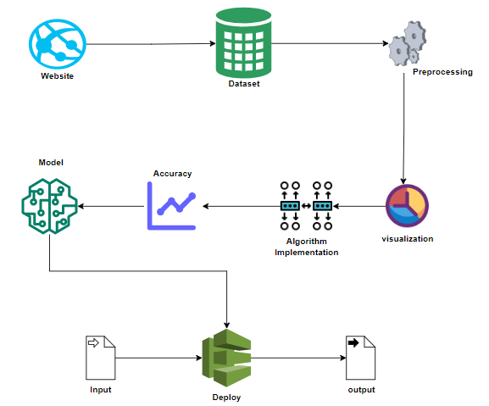
SYSTEM ARCHITECTURE

Slide 10
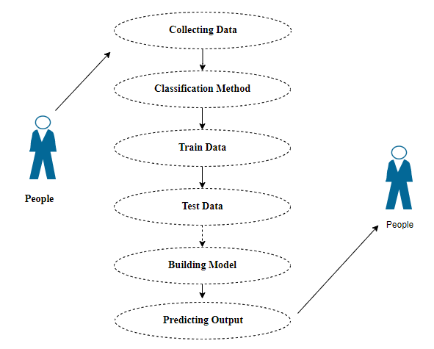
USE CASE DIAGRAM

Slide 11
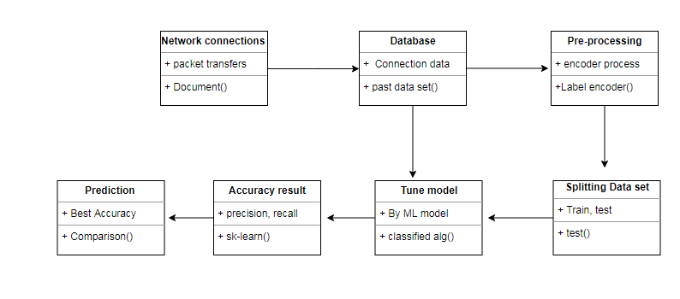
CLASS DIAGRAM

Slide 12
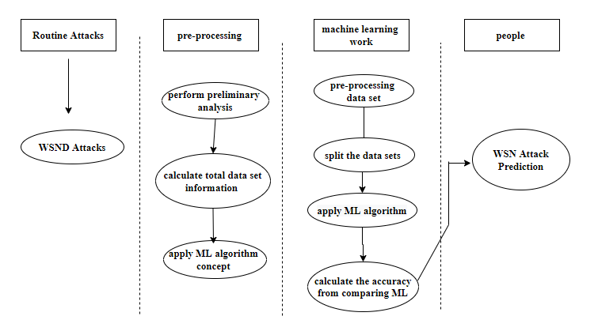
ACTIVITY DIAGRAM

Slide 13
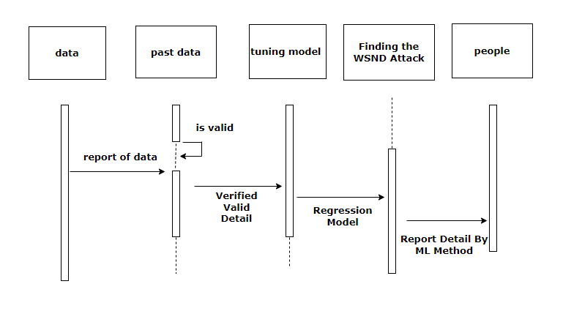
SEQUENCE DIAGRAM

Slide 14

LIST OF MODULES
Data Pre-processing
Data Analysis of Visualization
Implementing Algorithm 1
Implementing Algorithm 2
Implementing Algorithm 3
Deployment

Slide 15

MODULE DESCRIPTION
DATA PRE-PROCESSING :
Identify and handle missing values within the dataset.
Detect and remove duplicate entries to ensure data integrity.
Determine the data types (e.g., float, integer) of variables for appropriate processing.
Utilize validation techniques to evaluate model performance on samples that may not fully represent the dataset population.
This process ensures unbiased evaluation during model tuning and hyperparameter optimization.

Slide 16

DATA VISUALISTION AND DATA ANALYSIS :
Complements quantitative descriptions in statistics and machine learning.
Essential for gaining qualitative insights, identifying patterns, outliers, and data issues.
Helps express key relationships visually, making them more accessible to stakeholders.
Enables exploratory data analysis and deeper understanding of datasets.
Further exploration can be done through recommended books on data visualization and exploratory data analysis.

Slide 17
ALGORITHMS
BernoulinNB
Rando forest Classifier
Ridge Classifier

Slide 18

ALGORITHM-1
BERNOULLIN NB
The Bernoulli Naive Bayes (Bernoulli NB) algorithm is a classification algorithm based on the principles of the Naive Bayes theorem.
It is specifically designed for binary classification problems, where the target variable has two possible classes
(e.g., spam or not spam, positive or negative sentiment).

Slide 19
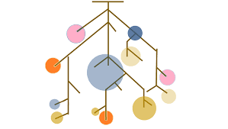
ALGORITHM-2
RANDOMFOREST CLASSIFIER:
A Random Forest Classifier is a powerful machine learning algorithm used for both classification and regression tasks.
Decision Trees:
At the heart of the Random Forest Classifier are decision trees. A decision tree is a simple tree-like structure that makes a sequence of binary decisions to classify data points.
Each internal node of the tree represents a decision based on a specific feature, and each leaf node represents a class label or a numerical value.

Slide 20
ALGORITHM-3
RIDGE CLASSIFIER
The Ridge Classifier is specifically designed for multi-class classification problems, where the goal is to assign an input data point to one of several predefined classes or categories.
Linear Model:
Like many other classification algorithms, the Ridge Classifier is based on a linear model.
It assumes that there is a linear relationship between the input features and the target classes.
Regularization:
It means that the algorithm uses L2 regularization to prevent overfitting.
Regularization helps in controlling the complexity of the model and reduces the risk of it fitting noise in the training data.

Slide 21

OUTPUT

Slide 22


OUTPUT

Slide 23
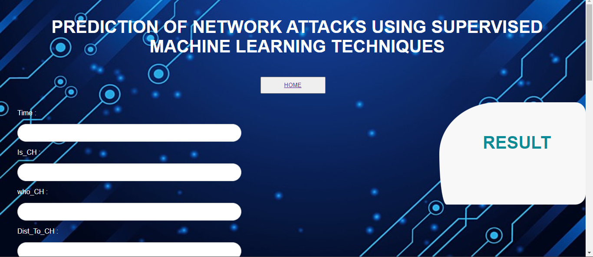
MODEL ANALYSIS

Slide 24
CONCLUSION
Analytical process encompassed data cleaning, processing, exploratory analysis, and model building.
Highest accuracy achieved on the public test set indicates superior performance.
Comparison of algorithms with different WSN attack types aids in selecting the most effective model for future predictions.
Insights gained facilitate the diagnosis of network attacks in new connections.
Presentation of a prediction model leveraging artificial intelligence promises enhanced accuracy surpassing human capabilities, enabling early detection.

Slide 25
FUTURE WORK
Network sector want to automate and detecting the attacks of packet transfers from eligibility process(real time) based on the connection detail.
To automate this process by show the prediction result in web application or desktop application at cloud.
To optimize the work to implement in artificial intelligence environment.

Slide 26
REFERENCE
KimK D.,and KumarP. (2012).Cyber–physical systems: A perspective at the centennial,in Proc. IEEE, http://www.ijeast.com.
ZhangH ., ShuY ., ChengP., and ChenJ.(2016).Privacy and performance trade-off in cyber-physical Systems,IEEE Network.
Manandhar K .,Cao X., HuF., and LiuY.(2014).Detection of faults and attacks including false data injection attack in smart grid using Kalman filter, IEEE Transactions on Control of Network Systems, vol.1, no.4, pp.370–379.
PasqualettiF,.D¨orfler F., and BulloF.,(2013).Attack Detection and Identification in Cyber-Physical Systems, IEEE Transactions on Automatic Control, vol.58, no.11, pp.2715–2729.
JiaQS., ShiL ., MoY., and SinopoliB., (2012). On optimal partial broadcasting of wireless sensor networks for kalman filtering, IEEE Transactions on Automatic Control, vol.57, no.3, pp.715–721.
LangnerR.,(2011). Stuxnet: Dissecting a cyberwarfare weapon,IEEE Security & Privacy, vol.9, no.3, pp.49–51.

Slide 27
THANK YOU

